Slide 1

Slide 10- <number>

Slide 2
Chapter 10
Functional Dependencies and Normalization for Relational Databases
Copyright © 2007 Ramez Elmasri and Shamkant B. Navathe

Slide 3
Chapter Outline
1 Informal Design Guidelines for Relational Databases
  1.1Semantics of the Relation Attributes
  1.2 Redundant Information in Tuples and Update Anomalies
  1.3 Null Values in Tuples
  1.4 Spurious Tuples
2 Functional Dependencies (FDs)
  2.1 Definition of FD
  2.2 Inference Rules for FDs
  2.3 Equivalence of Sets of FDs
  2.4 Minimal Sets of FDs
Slide 10- <number>

Slide 4
Chapter Outline
3 Normal Forms Based on Primary Keys
  3.1 Normalization of Relations
  3.2 Practical Use of Normal Forms
  3.3 Definitions of Keys and Attributes Participating in Keys
  3.4 First Normal Form
  3.5 Second Normal Form
  3.6 Third Normal Form
4 General Normal Form Definitions (For Multiple Keys)
5 BCNF (Boyce-Codd Normal Form)
Slide 10- <number>

Slide 5
Relational model
Relational schema
Two ways to form relational schema
  Attributed grouped together to form reln,schema
  Mapping db design form conceptual model’
  Designers perspective and no rules followed
Slide 10- <number>

Slide 6
Formal way of evaluation of db design quality
2 levels at which we assess the goodness of reln.schema:
  Logical level/conceptual level (base, view reln)
  Implementation/physical storage level (base reln)
  The reln.db design theory applies to base relation
Slide 10- <number>

Slide 7
DB design approaches
Bottom up
Top down
  Decomposition
  Goal of design activity:
    Information preservation
    Minimum redundancy
Slide 10- <number>

Slide 8
1 Informal Design Guidelines for Relational Databases (1)
What is relational database design?
  The grouping of attributes to form "good" relation schemas
Two levels of relation schemas
  The logical "user view" level
  The storage "base relation" level
Design is concerned mainly with base relations
What are the criteria for "good" base relations?
Slide 10- <number>

Slide 9
Informal Design Guidelines for Relational Databases (2)
We first discuss informal guidelines for good relational design
Then we discuss formal concepts of functional dependencies and normal forms
  - 1NF (First Normal Form)
  - 2NF (Second Normal Form)
  - 3NF (Third Normal Form)
  - BCNF (Boyce-Codd Normal Form)
Additional types of dependencies, further normal forms, relational design algorithms by synthesis are discussed in Chapter 11
Slide 10- <number>

Slide 10
1.1 Semantics of the Relation Attributes
GUIDELINE 1: Informally, each tuple in a relation should represent one entity or relationship instance. (Applies to individual relations and their attributes).
  Attributes of different entities (EMPLOYEEs, DEPARTMENTs, PROJECTs) should not be mixed in the same relation
  Only foreign keys should be used to refer to other entities
  Entity and relationship attributes should be kept apart as much as possible.
Bottom Line: Design a schema that can be explained easily relation by relation. The semantics of attributes should be easy to interpret.
Slide 10- <number>

Slide 11
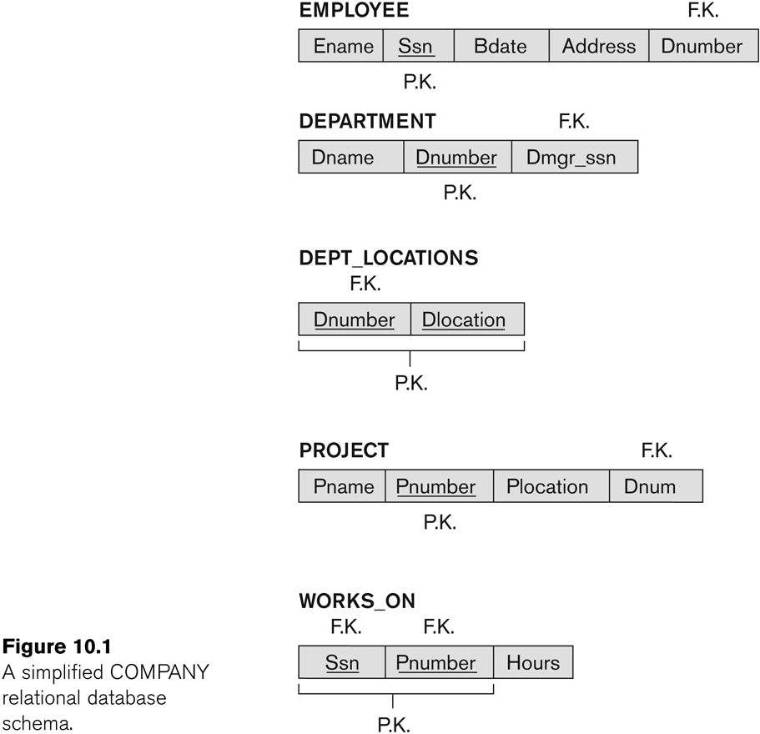
Figure 10.1 A simplified COMPANY relational database schema
Slide 10- <number>

Slide 12
1.2 Redundant Information in Tuples and Update Anomalies
Information is stored redundantly
  Wastes storage
  Causes problems with update anomalies
    Insertion anomalies
    Deletion anomalies
    Modification anomalies
Slide 10- <number>

Slide 13
EXAMPLE OF AN UPDATE ANOMALY
Consider the relation:
  EMP_PROJ(Emp#, Proj#, Ename, Pname, No_hours)
Modification Anomaly:
  Changing the name of project number P1 from “Billing” to “Customer-Accounting” may cause this update to be made for all 100 employees working on project P1.
Slide 10- <number>

Slide 14
EXAMPLE OF AN INSERT ANOMALY
Consider the relation:
  EMP_PROJ(Emp#, Proj#, Ename, Pname, No_hours)
Insert Anomaly:
  Cannot insert a project unless an employee is assigned to it.
Conversely
  Cannot insert an employee unless an he/she is assigned to a project.
Slide 10- <number>

Slide 15
EXAMPLE OF AN DELETE ANOMALY
Consider the relation:
  EMP_PROJ(Emp#, Proj#, Ename, Pname, No_hours)
Delete Anomaly:
  When a project is deleted, it will result in deleting all the employees who work on that project.
  Alternately, if an employee is the sole employee on a project, deleting that employee would result in deleting the corresponding project.
Slide 10- <number>

Slide 16
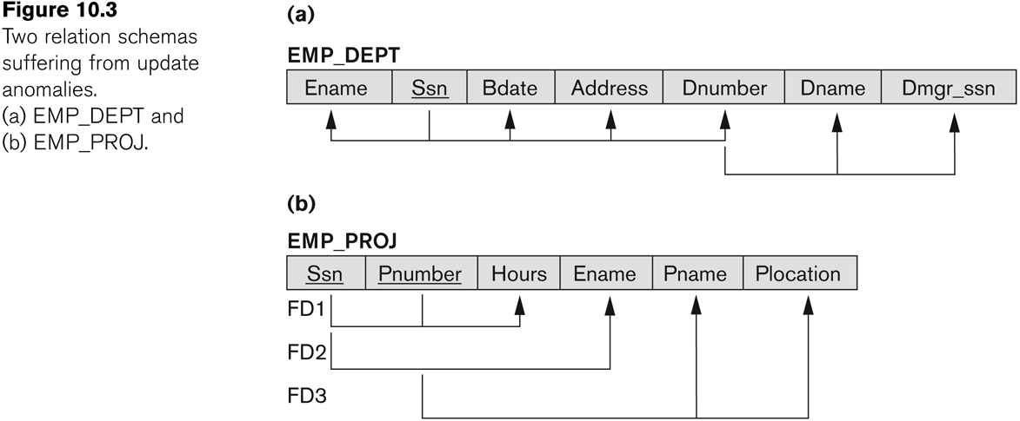
Figure 10.3 Two relation schemas suffering from update anomalies
Slide 10- <number>

Slide 17
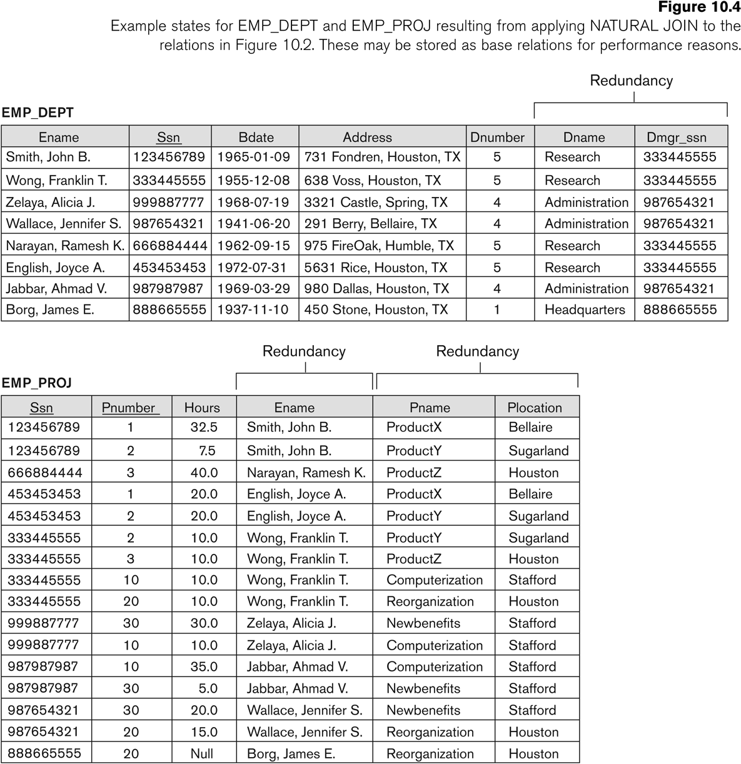
Figure 10.4 Example States for EMP_DEPT and EMP_PROJ
Slide 10- <number>

Slide 18
Guideline to Redundant Information in Tuples and Update Anomalies
GUIDELINE 2:
  Design a schema that does not suffer from the insertion, deletion and update anomalies.
  If there are any anomalies present, then note them so that applications can be made to take them into account.
Slide 10- <number>

Slide 19
1.3 Null Values in Tuples
GUIDELINE 3:
  Relations should be designed such that their tuples will have as few NULL values as possible
  Attributes that are NULL frequently could be placed in separate relations (with the primary key)
Reasons for nulls:
  Attribute not applicable or invalid
  Attribute value unknown (may exist)
  Value known to exist, but unavailable
Slide 10- <number>

Slide 20
1.4 Spurious Tuples
Bad designs for a relational database may result in erroneous results for certain JOIN operations
The "lossless join" property is used to guarantee meaningful results for join operations
GUIDELINE 4:
  The relations should be designed to satisfy the lossless join condition.
  No spurious tuples should be generated by doing a natural-join of any relations.
Slide 10- <number>

Slide 21
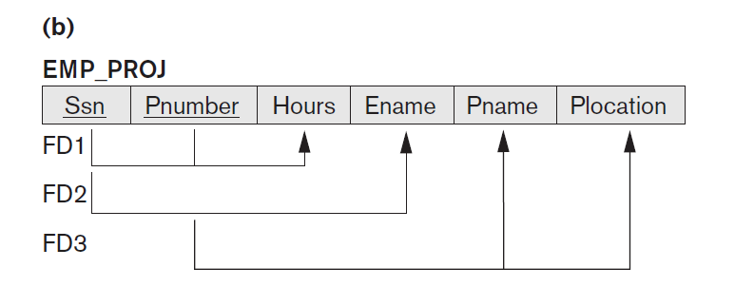
Slide 10- <number>

Slide 22
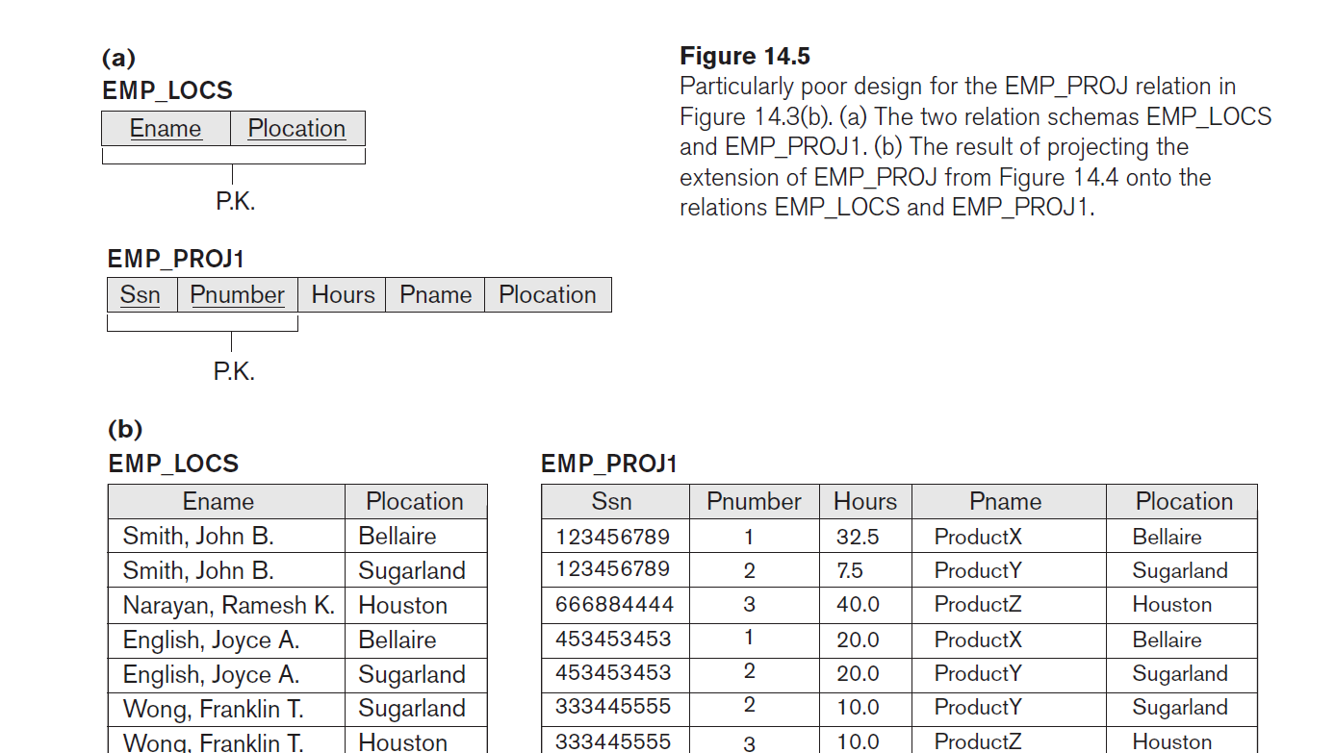
Slide 10- <number>

Slide 23
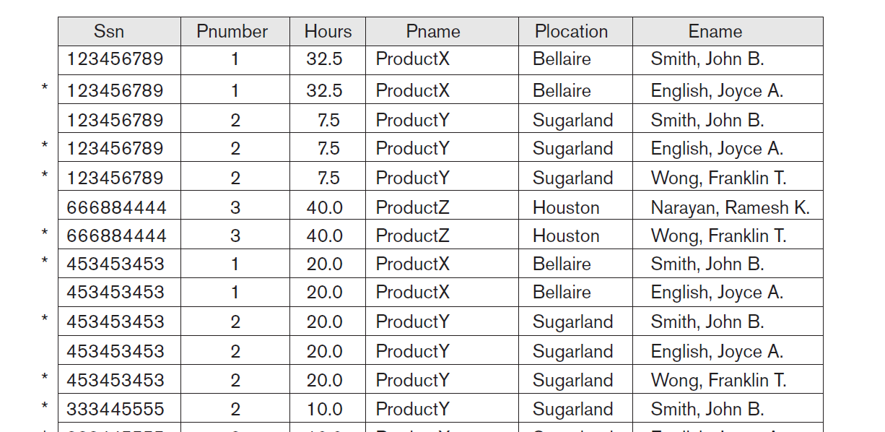
Slide 10- <number>

Slide 24
Spurious Tuples (2)
There are two important properties of decompositions:
  Non-additive or losslessness of the corresponding join
  Preservation of the functional dependencies.
Note that:
  Property (a) is extremely important and cannot be sacrificed.
  Property (b) is less stringent and may be sacrificed. (See Chapter 11).
Slide 10- <number>

Slide 25
Decomposition
Technique used in normalization
Many problems arising from redundancy can be addressed by replacing a relation with collection of smaller relation – decomposition
Slide 10- <number>

Slide 26
Decomposition of a Relation Schema
If a relation is not in a desired normal form, it can be decomposed into multiple relations that each are in that normal form.
Suppose that relation R contains attributes A1 ... An. A decomposition of R consists of replacing R by two or more relations such that:
  Each new relation scheme contains a subset of the attributes of R, and
  Every attribute of R appears as an attribute of at least one of the new relations.

Slide 27
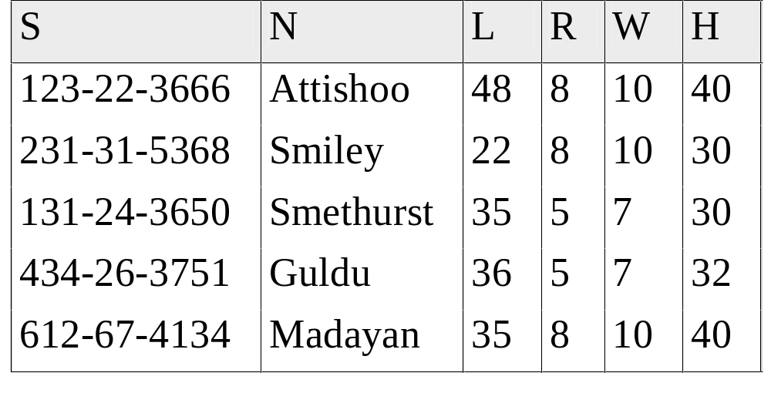
Example: imagine this relation is to be decomposed (reason will discuss later)
Slide 10- <number>

Slide 28

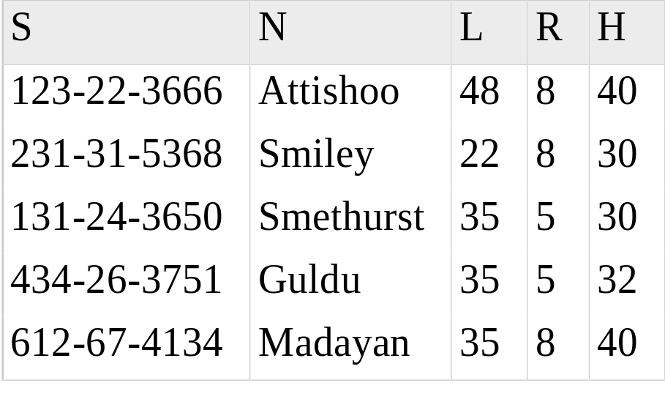
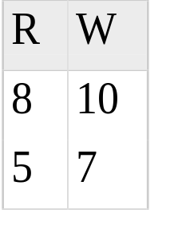
Wages
Hourly_Emps2
Slide 10- <number>

Slide 29
There are two important properties of decompositions:
  Non-additive or losslessness of the corresponding join
  Preservation of the functional dependencies.
Slide 10- <number>

Slide 30
The nonadditive join or lossless join property, which guarantees that the spurious tuple generation problem does not occur with respect to the relation schemas created after decomposition
The dependency preservation property, which ensures that each functional dependency is represented in some individual relation resulting after decomposition
Slide 10- <number>

Slide 31
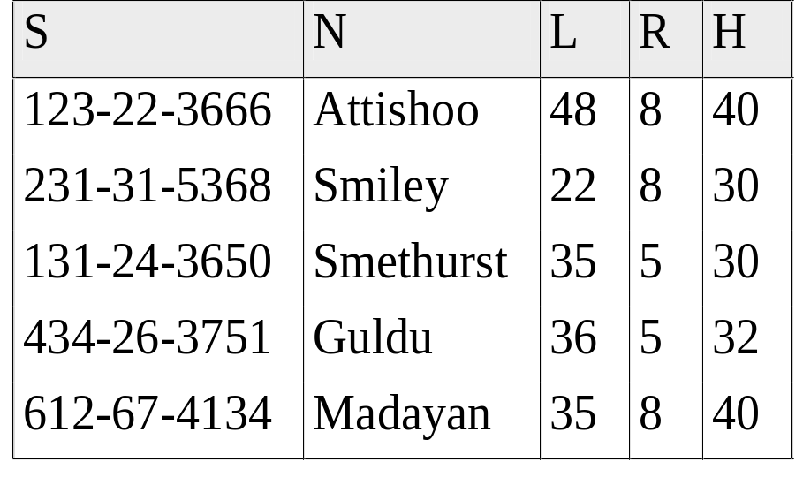


Lossless Decomposition (example)
=

Slide 32
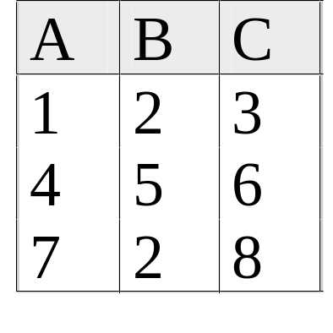
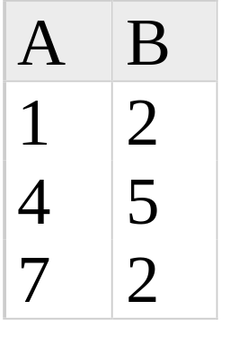
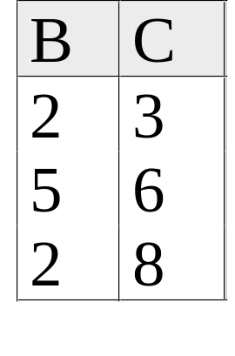
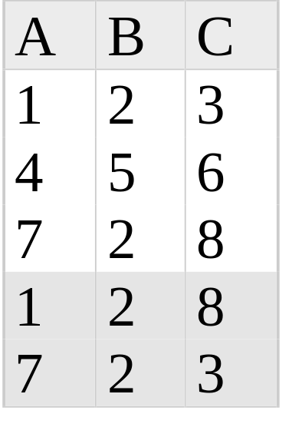
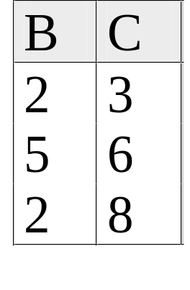
Lossy Decomposition (example)
A → B; C → B
=

Slide 33
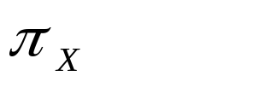
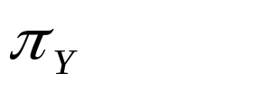

Lossless Join Decompositions
Decomposition of R into X and Y is lossless-join w.r.t. a set of FDs F if, for every instance r that satisfies F:
  (r) (r) = r
It is always true that r (r) (r)
  In general, the other direction does not hold! If it does, the decomposition is lossless-join.
Definition extended to decomposition into 3 or more relations in a straightforward way.
It is essential that all decompositions used to deal with redundancy be lossless! (Avoids Problem #1)

Slide 34
More on Lossless Decomposition
The decomposition of R into X and Y is lossless with respect to F if and only if the closure of F contains:
  X ∩ Y → X, or
  X ∩ Y → Y
  I.E.: decomposing ABC into AB and BC is lossy, because intersection (i.e., “B”) is not a key of either resulting relation.
Useful result: If W → Z holds over R and W ∩ Z is empty, then decomposition of R into R-Z and WZ is loss-less.

Slide 35
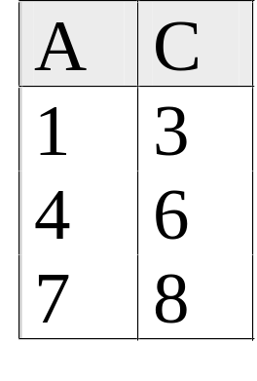
Lossless Decomposition (example)
A → B; C → B
=
But, now we can’t check A → B without doing a join!

Slide 36
Dependency Preserving Decomposition
Dependency preserving decomposition (Intuitive):
  If R is decomposed into X, Y and Z, and we enforce the FDs that hold individually on X, on Y and on Z, then all FDs that were given to hold on R must also hold.
Projection of set of FDs F : If R is decomposed into X and Y the projection of F on X (denoted F_{X} ) is the set of FDs U → V in F⁺ (closure of F , not just F ) such that all of the attributes U, V are in X. (same holds for Y of course)

Slide 37
Dependency Preserving Decompositions (Contd.)
Decomposition of R into X and Y is dependency preserving if (F_{X} ∪ F_{Y} ) ⁺ = F ⁺
  i.e., if we consider only dependencies in the closure F ⁺ that can be checked in X without considering Y, and in Y without considering X, these imply all dependencies in F ⁺.
Important to consider F ⁺ in this definition:
  ABC, A → B, B → C, C → A, decomposed into AB and BC.
  Is this dependency preserving? Is C → A preserved?????
    note: F ⁺ contains F ∪ {A → C, B → A, C → B}, so…
FAB contains A →B and B → A; FBC contains B → C and C → B
So, (FAB ∪ FBC)⁺ contains C → A

Slide 38
2.1 Functional Dependencies (1)
Functional dependencies (FDs)
  Are used to specify formal measures of the "goodness" of relational designs
  And keys are used to define normal forms for relations
  Are constraints that are derived from the meaning and interrelationships of the data attributes
A set of attributes X functionally determines a set of attributes Y if the value of X determines a unique value for Y
Slide 10- <number>

Slide 39
Functional Dependencies (2)
X -> Y , Y is functionally dependent on X
X -> Y holds if whenever two tuples have the same value for X, they must have the same value for Y
  For any two tuples t1 and t2 in any relation instance r(R): If t1[X]=t2[X], then t1[Y]=t2[Y]
X -> Y in R specifies a constraint on all relation instances r(R)
Written as X -> Y; can be displayed graphically on a relation schema as in Figures. ( denoted by the arrow: ).
FDs are derived from the real-world constraints on the attributes
Slide 10- <number>

Slide 40
Examples of FD constraints (1)
Social security number determines employee name
  SSN -> ENAME
Project number determines project name and location
  PNUMBER -> {PNAME, PLOCATION}
Employee ssn and project number determines the hours per week that the employee works on the project
  {SSN, PNUMBER} -> HOURS
Slide 10- <number>

Slide 41
Examples of FD constraints (2)
An FD is a property of the attributes in the schema R
The constraint must hold on every relation instance r(R)
If K is a key of R, then K functionally determines all attributes in R
  (since we never have two distinct tuples with t1[K]=t2[K])
Slide 10- <number>

Slide 42
Inference Rules for Functional Dependencies/ Armstrong’s Axioms
how new dependencies can be inferred from a given set
and discuss the concepts of closure, equivalence, and minimal cover that is required in synthesis approach to design of relations given a set of FD
Slide 10- <number>

Slide 43
2.2 Inference Rules for FDs (1)
Given a set of FDs F, we can infer additional FDs that hold whenever the FDs in F hold
Armstrong's inference rules:
  IR1. (Reflexive) If Y subset-of X, then X -> Y
  IR2. (Augmentation) If X -> Y, then XZ -> YZ
    (Notation: XZ stands for X U Z)
  IR3. (Transitive) If X -> Y and Y -> Z, then X -> Z
IR1, IR2, IR3 form a sound and complete set of inference rules
  These are rules hold and all other rules that hold can be deduced from these
Slide 10- <number>

Slide 44
Inference Rules for FDs (2)
Some additional inference rules that are useful:
  Decomposition: If X -> YZ, then X -> Y and X -> Z
  Union: If X -> Y and X -> Z, then X -> YZ
  Psuedotransitivity: If X -> Y and WY -> Z, then WX -> Z
  Solun: WX -> WY , WY -> Z THUS, WX -> Z
The last three inference rules, as well as any other inference rules, can be deduced from IR1, IR2, and IR3 (completeness property)
Slide 10- <number>

Slide 45
Inference Rules for FDs (3)
Closure of a set F of FDs is the set F⁺ of all FDs that can be inferred from F
Closure of a set of attributes X with respect to F is the set X⁺ of all attributes that are functionally determined by X
X⁺ can be calculated by repeatedly applying IR1, IR2, IR3 using the FDs in F
Slide 10- <number>

Slide 46
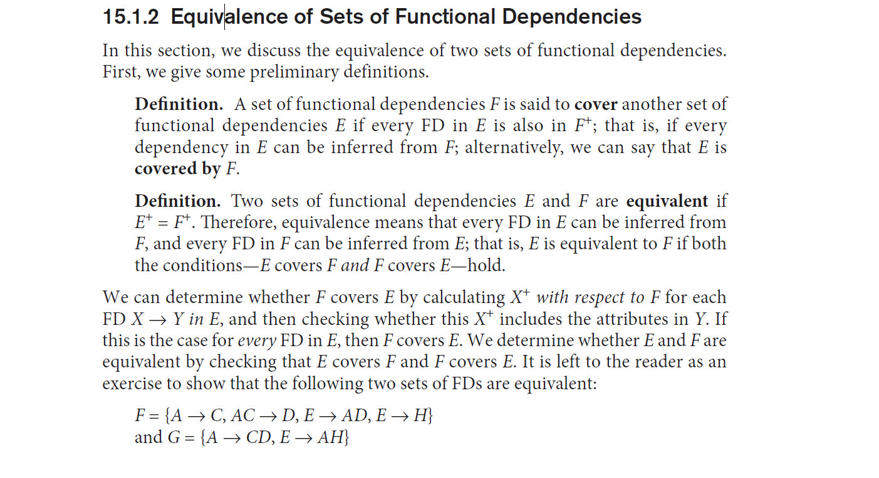
Slide 10- <number>

Slide 47
2.3 Equivalence of Sets of FDs
Two sets of FDs F and G are equivalent if:
  Every FD in F can be inferred from G, and
  Every FD in G can be inferred from F
  Hence, F and G are equivalent if F⁺ =G⁺
Definition (Covers):
  F covers G if every FD in G can be inferred from F
    (i.e., if G⁺ subset-of F⁺)
F and G are equivalent if F covers G and G covers F
There is an algorithm for checking equivalence of sets of FDs
Slide 10- <number>

Slide 48
Minimal set of functional dependency
Minimal cover
Extraneous attribute
Slide 10- <number>

Slide 49
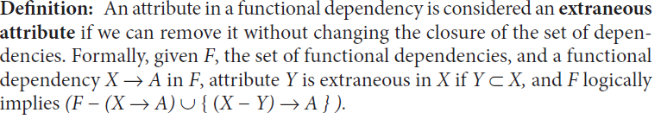
Slide 10- <number>

Slide 50
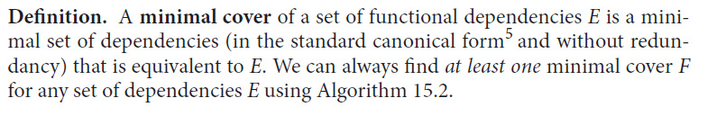
Slide 10- <number>

Slide 51
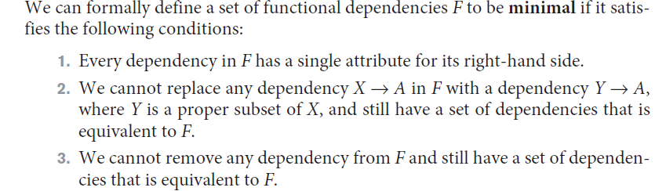
Slide 10- <number>

Slide 52
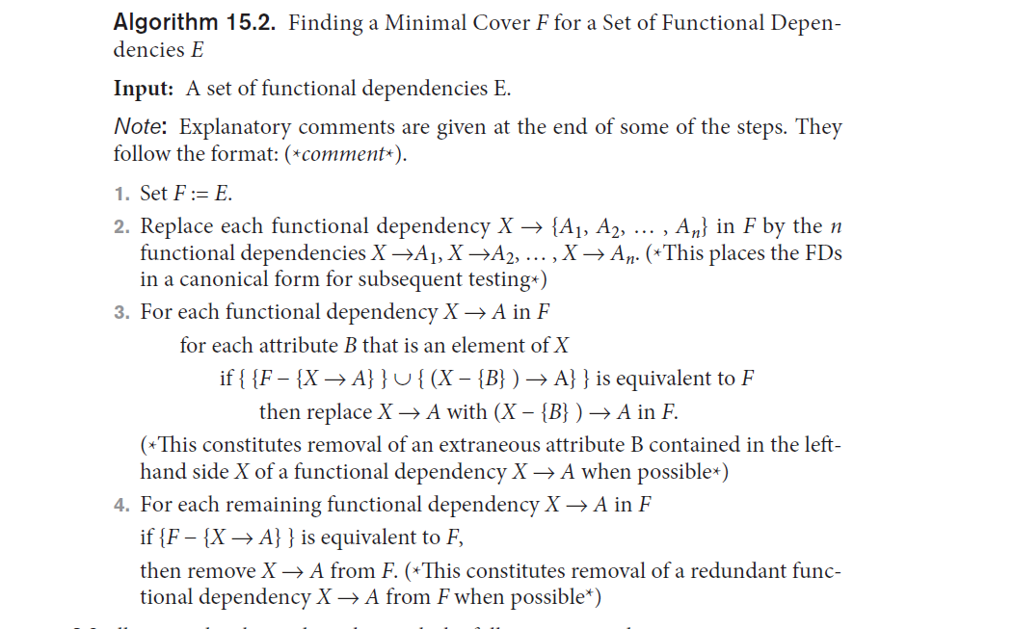
Slide 10- <number>

Slide 53
2.4 Minimal Sets of FDs (1)
A set of FDs is minimal if it satisfies the following conditions:
  Every dependency in F has a single attribute for its RHS.
  We cannot remove any dependency from F and have a set of dependencies that is equivalent to F.
  We cannot replace any dependency X -> A in F with a dependency Y -> A, where Y proper-subset-of X ( Y subset-of X) and still have a set of dependencies that is equivalent to F.
Slide 10- <number>

Slide 54
Minimal Sets of FDs (2)
Every set of FDs has an equivalent minimal set
There can be several equivalent minimal sets
There is no simple algorithm for computing a minimal set of FDs that is equivalent to a set F of FDs
To synthesize a set of relations, we assume that we start with a set of dependencies that is a minimal set
  E.g., see algorithms 11.2 and 11.4
Slide 10- <number>

Slide 55
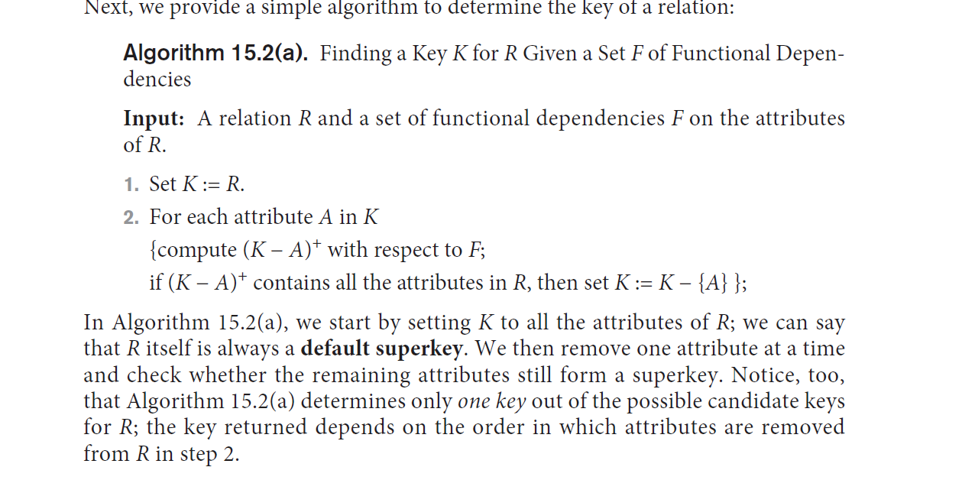
Slide 10- <number>

Slide 56
3 Normal Forms Based on Primary Keys
3.1 Normalization of Relations
3.2 Practical Use of Normal Forms
3.3 Definitions of Keys and Attributes Participating in Keys
3.4 First Normal Form
3.5 Second Normal Form
3.6 Third Normal Form
Slide 10- <number>

Slide 57
3.1 Normalization of Relations (1)
Normalization:
  The process of decomposing unsatisfactory "bad" relations by breaking up their attributes into smaller relations
Normal form:
  Condition using keys and FDs of a relation to certify whether a relation schema is in a particular normal form
Slide 10- <number>

Slide 58
Normalization:
Process of analysing the given relation schemas based on their functional dependency and primary keys to achieve desirable properties of
Minimizing redundancy
Minimizing insertion, deletion and update anomalies
Normal form:
A relation refers to the highest normal form condition that it meets and hence indicates the degree to which it has been normalized.
Slide 10- <number>

Slide 59
Note :
While decomposing a relation to achieve a desired form, it is also vital to include two properties:
Nonadditive join or lossless join property
Dependency preservation property
Slide 10- <number>

Slide 60
Normalization of Relations (2)
2NF, 3NF, BCNF
  based on keys and FDs of a relation schema
4NF
  based on keys, multi-valued dependencies : MVDs; 5NF based on keys, join dependencies : JDs (Chapter 11)
Additional properties may be needed to ensure a good relational design (lossless join, dependency preservation; Chapter 11)
Slide 10- <number>

Slide 61
3.2 Practical Use of Normal Forms
Normalization is carried out in practice so that the resulting designs are of high quality and meet the desirable properties
The practical utility of these normal forms becomes questionable when the constraints on which they are based are hard to understand or to detect
The database designers need not normalize to the highest possible normal form
  (usually up to 3NF, BCNF or 4NF)
Denormalization:
  The process of storing the join of higher normal form relations as a base relation—which is in a lower normal form
Slide 10- <number>

Slide 62
3.3 Definitions of Keys and Attributes Participating in Keys (1)
A superkey of a relation schema R = {A1, A2, ...., An} is a set of attributes S subset-of R with the property that no two tuples t1 and t2 in any legal relation state r of R will have t1[S] = t2[S]
A key K is a superkey with the additional property that removal of any attribute from K will cause K not to be a superkey any more.
Slide 10- <number>

Slide 63
Definitions of Keys and Attributes Participating in Keys (2)
If a relation schema has more than one key, each is called a candidate key.
  One of the candidate keys is arbitrarily designated to be the primary key, and the others are called secondary keys.
A Prime attribute must be a member of some candidate key
A Nonprime attribute is not a prime attribute—that is, it is not a member of any candidate key.
Slide 10- <number>

Slide 64
First normal form
1NF is now considered to be part of the formal definition of a relation in the basic relational model.
Historically it was designed to disallow multivalued attributes, composite attributes and their combinations
It states that domain of an attribute must include only atomic (simple, indivisible) values and that the value of any attribute in a tuple must be a single value from the domain of that attribute.
Slide 10- <number>

Slide 65
3.2 First Normal Form
Disallows
  composite attributes
  multivalued attributes
  nested relations; attributes whose values for an individual tuple are non-atomic
Considered to be part of the definition of relation
Slide 10- <number>

Slide 66

Figure 10.8 Normalization into 1NF
Slide 10- <number>

Slide 67
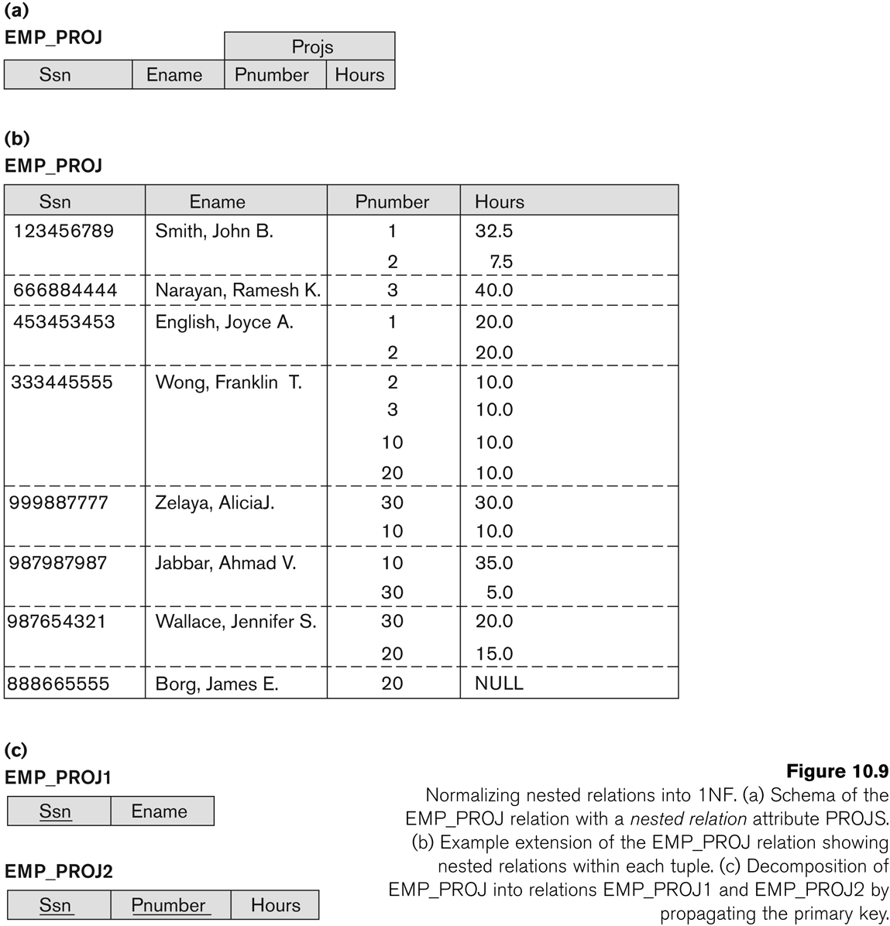
Figure 10.9 Normalization nested relations into 1NF
Slide 10- <number>

Slide 68
3.3 Second Normal Form (1)
Uses the concepts of FDs, primary key
Definitions
  Prime attribute: An attribute that is member of the primary key K
  Full functional dependency: a FD Y -> Z where removal of any attribute from Y means the FD does not hold any more
Examples:
  {SSN, PNUMBER} -> HOURS is a full FD since neither SSN -> HOURS nor PNUMBER -> HOURS hold
  {SSN, PNUMBER} -> ENAME is not a full FD (it is called a partial dependency ) since SSN -> ENAME also holds
Slide 10- <number>

Slide 69
Second Normal Form (2)
A relation schema R is in second normal form (2NF) if every non-prime attribute A in R is fully functionally dependent on the primary key
R can be decomposed into 2NF relations via the process of 2NF normalization
Slide 10- <number>

Slide 70
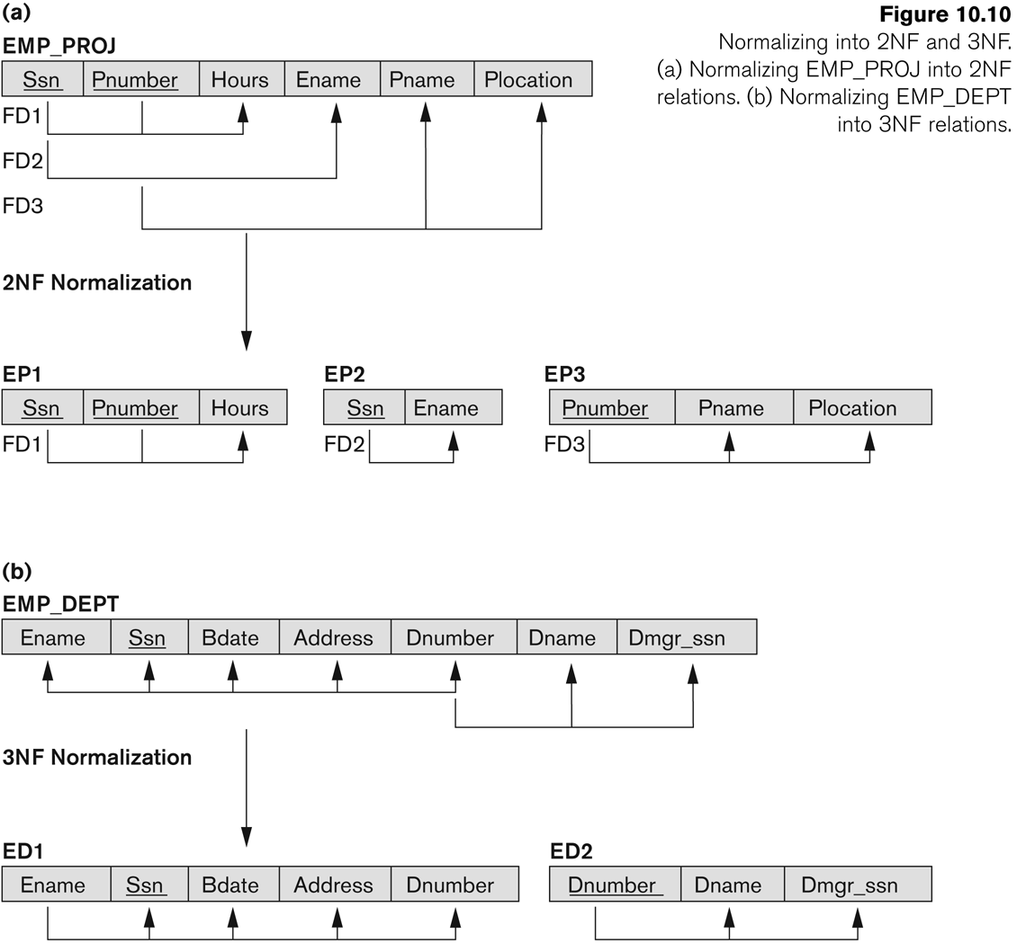
Figure 10.10 Normalizing into 2NF and 3NF
Slide 10- <number>

Slide 71
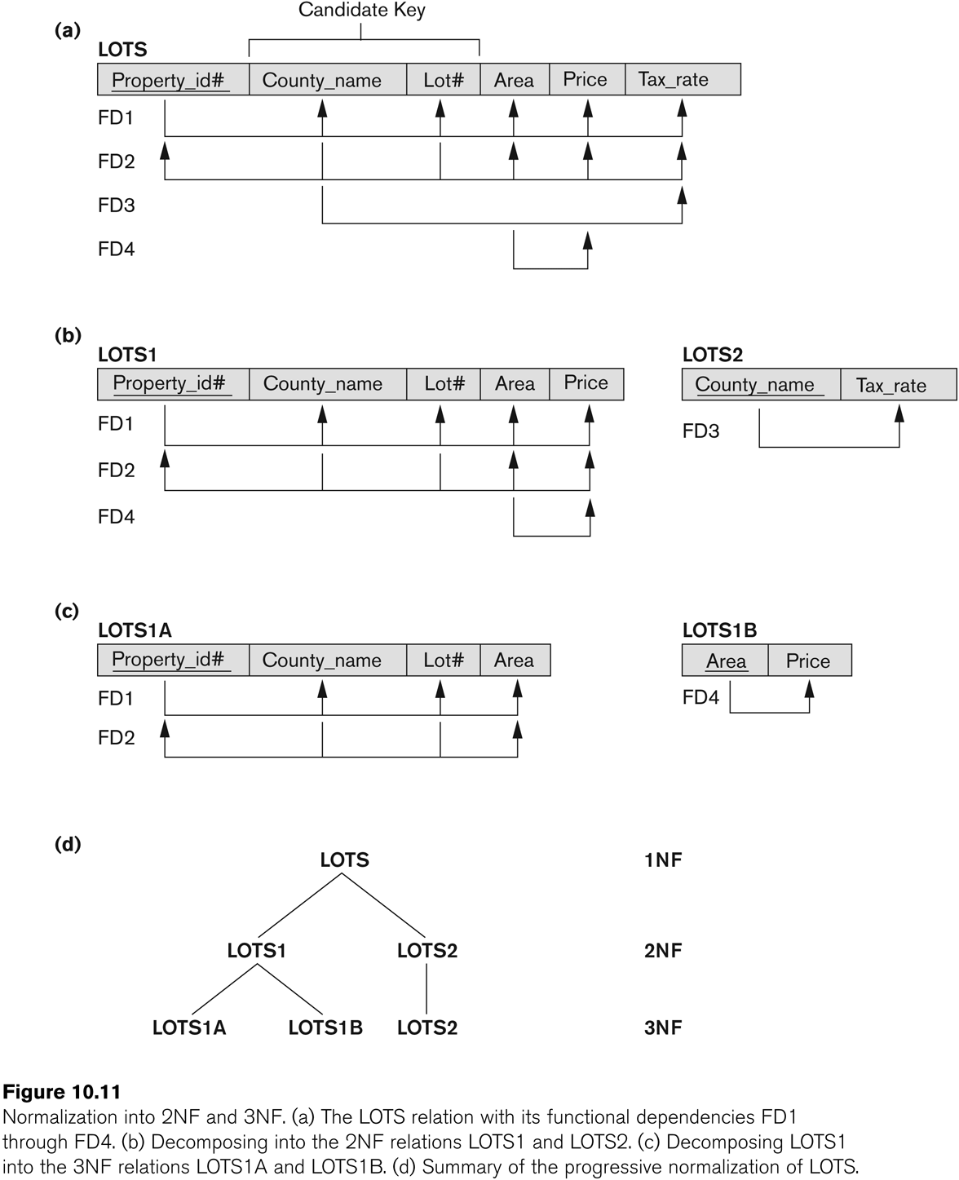
Figure 10.11 Normalization into 2NF and 3NF
Slide 10- <number>

Slide 72
3.4 Third Normal Form (1)
Definition:
  Transitive functional dependency: a FD X -> Z that can be derived from two FDs X -> Y and Y -> Z
Examples:
  SSN -> DMGRSSN is a transitive FD
    Since SSN -> DNUMBER and DNUMBER -> DMGRSSN hold
  SSN -> ENAME is non-transitive
    Since there is no set of attributes X where SSN -> X and X -> ENAME
Slide 10- <number>

Slide 73
Third Normal Form (2)
A relation schema R is in third normal form (3NF) if it is in 2NF and no non-prime attribute A in R is transitively dependent on the primary key
R can be decomposed into 3NF relations via the process of 3NF normalization
NOTE:
  In X -> Y and Y -> Z, with X as the primary key, we consider this a problem only if Y is not a candidate key.
  When Y is a candidate key, there is no problem with the transitive dependency .
  E.g., Consider EMP (SSN, Emp#, Salary ).
    Here, SSN -> Emp# -> Salary and Emp# is a candidate key.
Slide 10- <number>

Slide 74
Normal Forms Defined Informally
1st normal form
  All attributes depend on the key
2nd normal form
  All attributes depend on the whole key
3rd normal form
  All attributes depend on nothing but the key
Slide 10- <number>

Slide 75
4 General Normal Form Definitions (For Multiple Keys) (1)
The above definitions consider the primary key only
The following more general definitions take into account relations with multiple candidate keys
A relation schema R is in second normal form (2NF) if every non-prime attribute A in R is fully functionally dependent on every key of R
Slide 10- <number>

Slide 76
General Normal Form Definitions (2)
Definition:
  Superkey of relation schema R - a set of attributes S of R that contains a key of R
  A relation schema R is in third normal form (3NF) if whenever a FD X -> A holds in R, then either:
    (a) X is a superkey of R, or
    (b) A is a prime attribute of R
NOTE: Boyce-Codd normal form disallows condition (b) above
Slide 10- <number>

Slide 77
5 BCNF (Boyce-Codd Normal Form)
A relation schema R is in Boyce-Codd Normal Form (BCNF) if whenever an nontrivial FD X -> A holds in R, then X is a superkey of R
Trivial functional dependency:
If a FD X->Y holds and if Y is a subset of X then x->y is a trivial FD
Eg:
Empid,empname->empid
Else its nontrivial
(any attribute that can determine value of another attribute[except primary key] then such dependency is nontrivial )
Slide 10- <number>

Slide 78
Each normal form is strictly stronger than the previous one
  Every 2NF relation is in 1NF
  Every 3NF relation is in 2NF
  Every BCNF relation is in 3NF
There exist relations that are in 3NF but not in BCNF
The goal is to have each relation in BCNF (or 3NF)
Slide 10- <number>

Slide 79
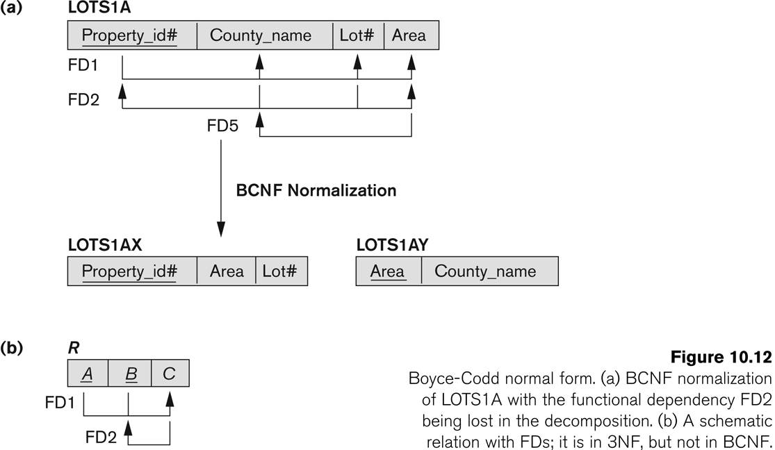
Figure 10.12 Boyce-Codd normal form
Slide 10- <number>

Slide 80
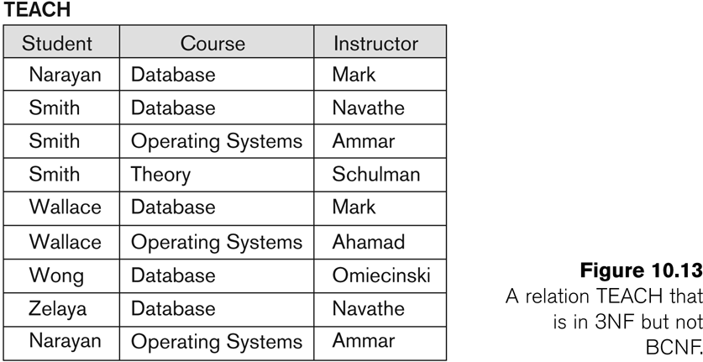
Figure 10.13 a relation TEACH that is in 3NF but not in BCNF
Slide 10- <number>

Slide 81
Achieving the BCNF by Decomposition (1)
Two FDs exist in the relation TEACH:
  fd1: { student, course} -> instructor
  fd2: instructor -> course
{student, course} is a candidate key for this relation and that the dependencies shown follow the pattern in Figure 10.12 (b).
  So this relation is in 3NF but not in BCNF
A relation NOT in BCNF should be decomposed so as to meet this property, while possibly forgoing the preservation of all functional dependencies in the decomposed relations.
  (See Algorithm 11.3)
Slide 10- <number>

Slide 82
Achieving the BCNF by Decomposition (2)
Three possible decompositions for relation TEACH
  {student, instructor} and {student, course}
  {course, instructor } and {course, student}
  {instructor, course } and {instructor, student}
All three decompositions will lose fd1.
  We have to settle for sacrificing the functional dependency preservation. But we cannot sacrifice the non-additivity property after decomposition.
Out of the above three, only the 3rd decomposition will not generate spurious tuples after join.(and hence has the non-additivity property).
A test to determine whether a binary decomposition (decomposition into two relations) is non-additive (lossless) is discussed in section 11.1.4 under Property LJ1. Verify that the third decomposition above meets the property.
Slide 10- <number>

Slide 83
Fourth Normal Form (4NF)
Multi-valued dependency (MVD)
  Represents a dependency between attributes (for example, A,B and C) in a relation, such that for each value of A there is a set of values for B and a set of value for C. However, the set of values for B and C are independent of each other.
A multi-valued dependency can be further defined as being trivial or nontrivial.
A MVD A →> B in relation R is defined as being trivial if
  B is a subset of A or
  A U B = R
A MVD is defined as being nontrivial if neither of the above two conditions is satisfied.
Slide 10- <number>

Slide 84
Fourth Normal Form (4NF)
Fourth normal form (4NF)
  A relation that is in Fourth normal form and contains no nontrivial multi-valued dependencies.
A relation schema R is in 4NF with respect to a set of dependencies F (that includes functional dependencies and multivalued dependencies) if, for every nontrivial multivalued dependency X →→ Y in F+, X is a superkey for R.
Slide 10- <number>

Slide 85
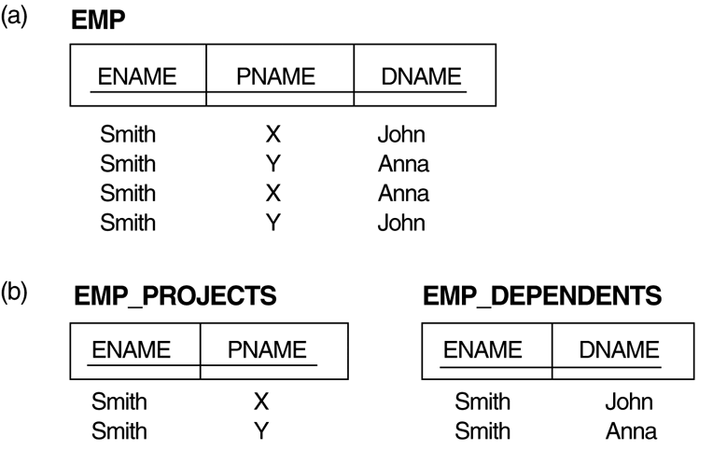
Multivalued Dependencies and Fourth Normal Form
The EMP relation with two MVDs: ENAME —>> PNAME and ENAME —>> DNAME.
Decomposing the EMP relation into two 4NF relations EMP_PROJECTS and EMP_DEPENDENTS
Slide 10- <number>

Slide 86
Fifth Normal Form (5NF) or
Project Join Normal Form ( PJNF )
Fifth normal form (5NF)
  A relation that has no join dependency.
Lossless-join dependency
  A property of decomposition, which ensures that no spurious tuples are generated when relations are reunited through a natural join operation.
Join dependency
  Describes a type of dependency. For example, for a relation R with subsets of the attributes of R denoted as A, B, …, Z, a relation R satisfies a join dependency if, and only if, every legal value of R is equal to the join of its projections on A, B, …, Z.
Slide 10- <number>

Slide 87
Definition. A relation schema R is in fifth normal form (5NF) (or project-join normal form (PJNF)) with respect to a set F of functional, multivalued, and join dependencies if, for every nontrivial join dependency JD(R1, R2, … , Rn) in F+ (that is, implied by F) every Ri is a superkey of R
Slide 10- <number>

Slide 88
Whenever:
a supplier s supplies part p, and a
project j uses part p, and the
supplier s supplies at least one part to project j,
then supplier s will also be supplying part p to project j.
This constraint can be restated in other ways and specifies a join dependency
JD(R1, R2, R3) among the three projections R1 (Sname, Part_name), R2 (Sname,Proj_name), and R3 (Part_name, Proj_name) of SUPPLY.
JD is trivial if JD(R1,R2,….RN) HAS R in it
Slide 10- <number>

Slide 89
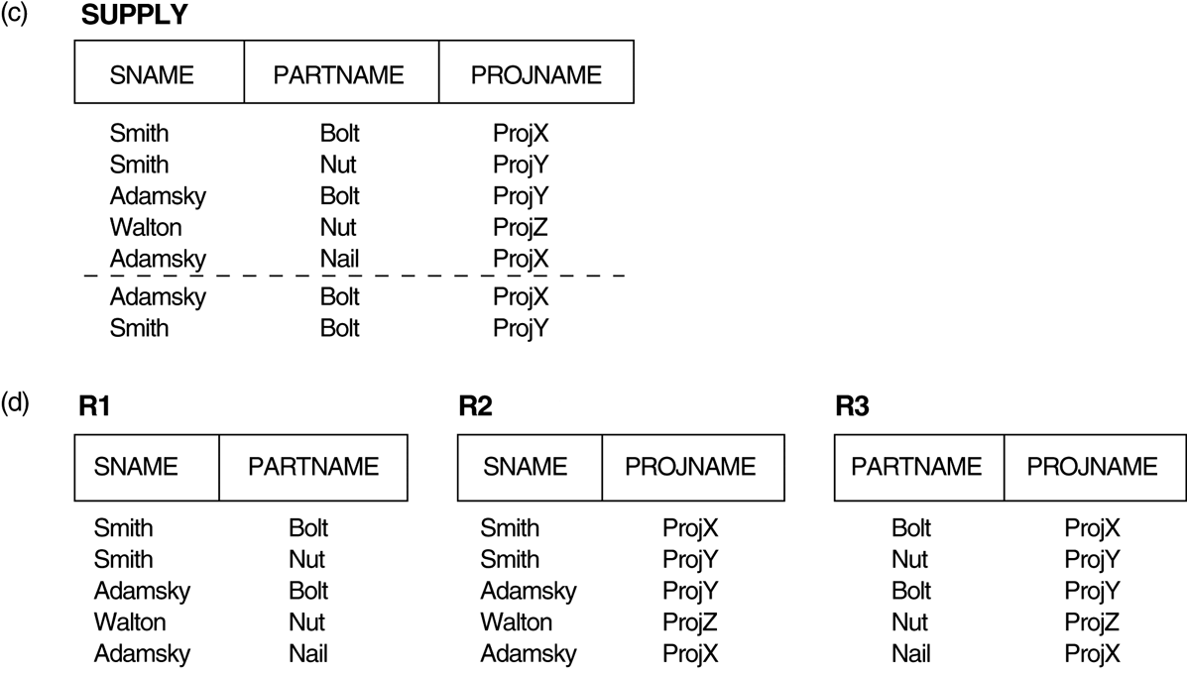
Relation SUPPLY with Join Dependency and conversion to Fifth Normal Form
(c) The relation SUPPLY with no MVDs is in 4NF but not in 5NF if it has the JD(R1, R2, R3).
(d) Decomposing the relation SUPPLY into the 5NF relations R1, R2, and R3.
Slide 10- <number>

Slide 90
Denormalization
Process of storing the join of higher normal form relations as a base relation, which is in a lower normal form.
Database optimization technique in which we add redundant data to one or more tables.
This can help us avoid costly joins in a relational database.
Denormalization does not mean not doing normalization.
It is an optimization technique that is applied after doing normalization.
Slide 10- <number>

Slide 91
Denormalization
It is sometimes necessary to use controlled redundancy to improve the performance of queries.
For example, we may store Student_name and Course_number redundantly in a GRADE_REPORT file (Figure 1.6(a)) because
whenever we retrieve a GRADE_REPORT record, we want to retrieve the student name and course number along with the grade, student number, and section identifier.
By placing all the data together, we do not have to search multiple files to collect this data.
This is known as denormalization. In such cases, the DBMS should
Slide 10- <number>

Slide 92
Denormalization
Have the capability to control this redundancy in order to prohibit inconsistencies among the files.
This may be done automatically by
Checking that the Student_name–Student_number values in any GRADE_REPORT record in figure (a) match one of the Name–Student_number values of a STUDENT record.
Similarly, the Section_identifier–Course_number values in GRADE_REPORT can be checked against SECTION records.
Such checks can be specified to the DBMS during database design and automatically enforced by the DBMS whenever the GRADE_REPORT file is updated.
Figure (b) shows a GRADE_REPORT record that is inconsistent with the STUDENT file
Slide 10- <number>

Slide 93

Denormalization Example
Slide 10- <number>

Slide 94
Pros and cons of Denormalization:-
Pros
  Retrieving data is faster since we do fewer joins.
  Queries to retrieve data can be simpler.
  we need to look at fewer tables.
Cons
  Updates and inserts are more expensive.
  Denormalization can make update and insert code harder to write.
  Data redundancy necessitates more storage.
  In a system that demands scalability, like that of any major tech companies, we almost always use elements of both normalized and denormalized databases.
Slide 10- <number>

Slide 95
Exercises
Given a relation with eight attributes and 4 functional dependancies. Normalize it upto 3rd Normal form
(P_no, P_name, Emp_no, Emp_name, Job_class, Charge_hrs, Hrs_billed and Tot_charges )
FD1 : P_no -> P_name
FD2 : Emp_no -> Emp_name, Job_class
FD3 : P_no , Emp_no -> Hrs_billed ,tot_charges
FD4 : Job_class -> Charge_hrs
Slide 10- <number>

Slide 96
Chapter Outline
Informal Design Guidelines for Relational Databases
Functional Dependencies (FDs)
  Definition, Inference Rules, Equivalence of Sets of FDs, Minimal Sets of FDs
Normal Forms Based on Primary Keys
General Normal Form Definitions (For Multiple Keys)
BCNF (Boyce-Codd Normal Form)
Slide 10- <number>

